Slide 1


Slide 2
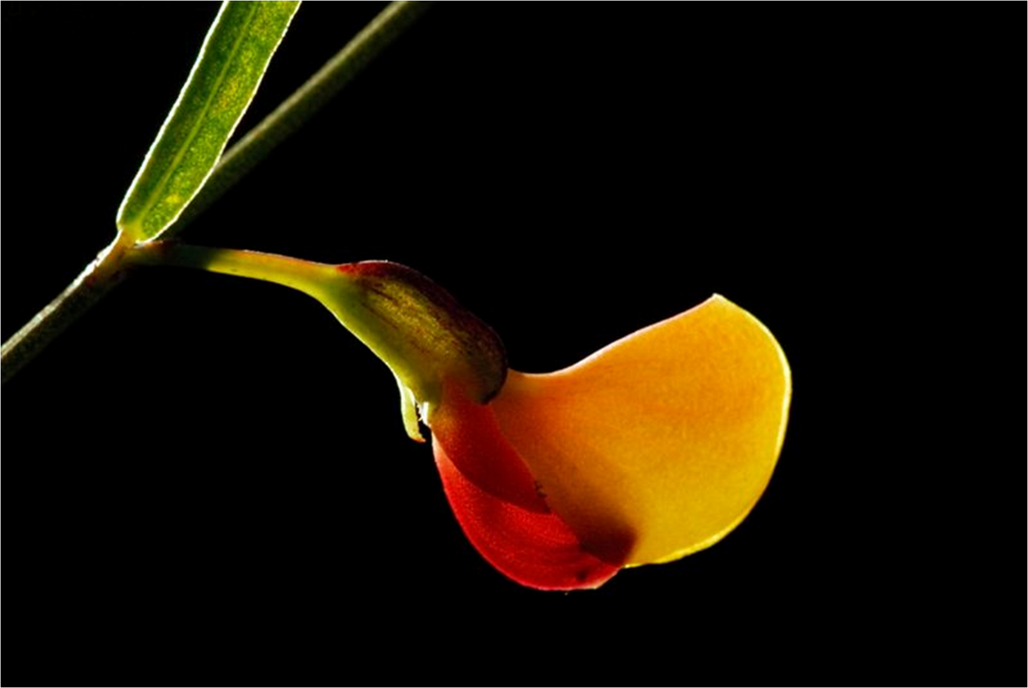
Standard Views in Transesophageal Echocardiography
Rasoul Azarfarin MD
Associate Professor of Anesthesiology
Fellowship of Cardiac Anesthesia

Slide 3
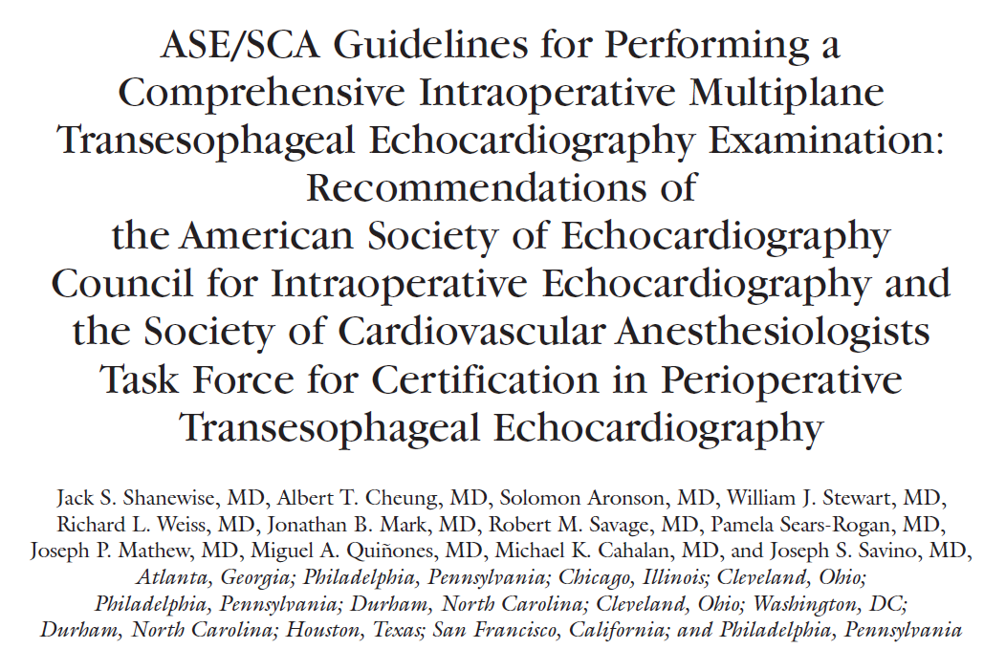

Slide 4
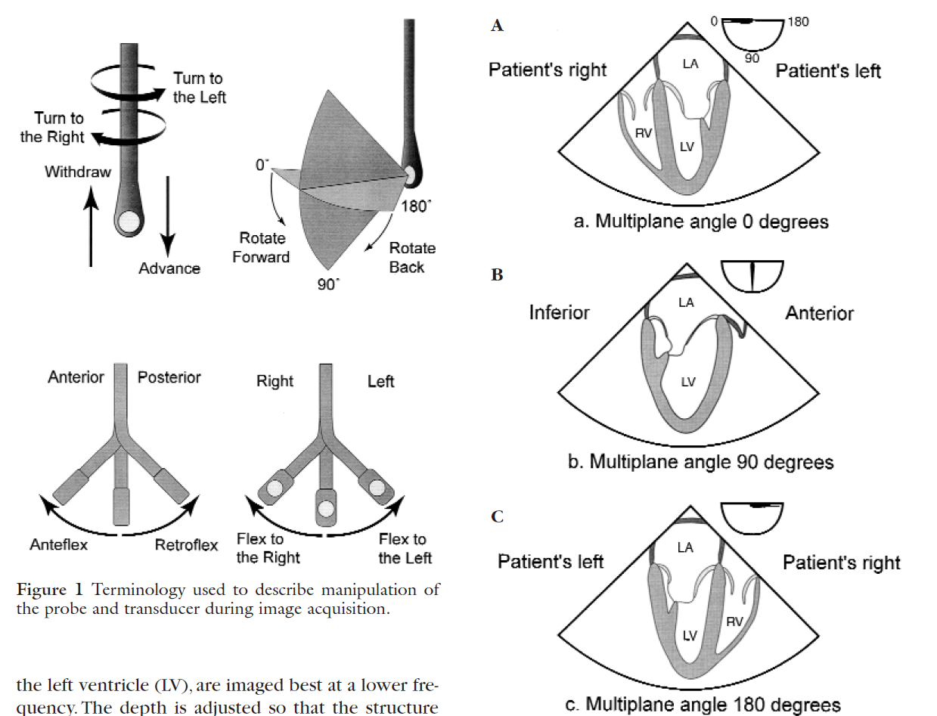

Slide 5
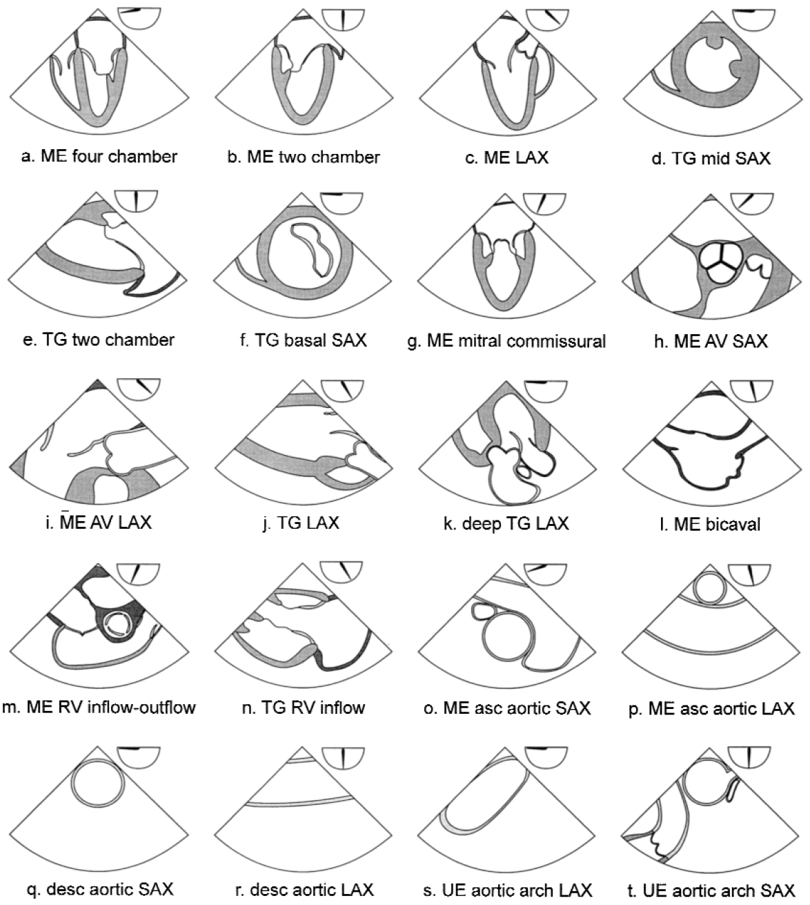
Cross-Sectional TEE Views

Slide 6
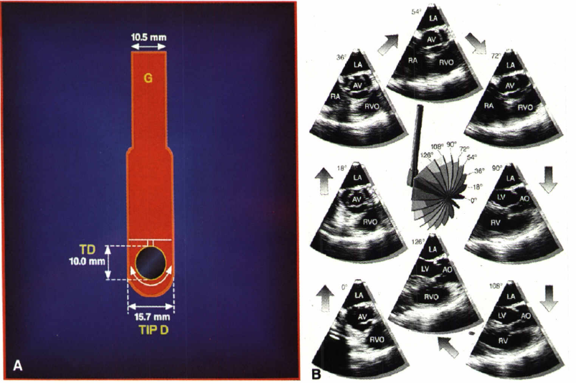
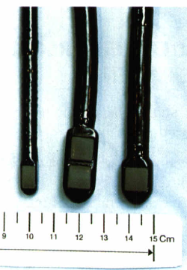
Multiplane angles (Rotation)

Slide 7
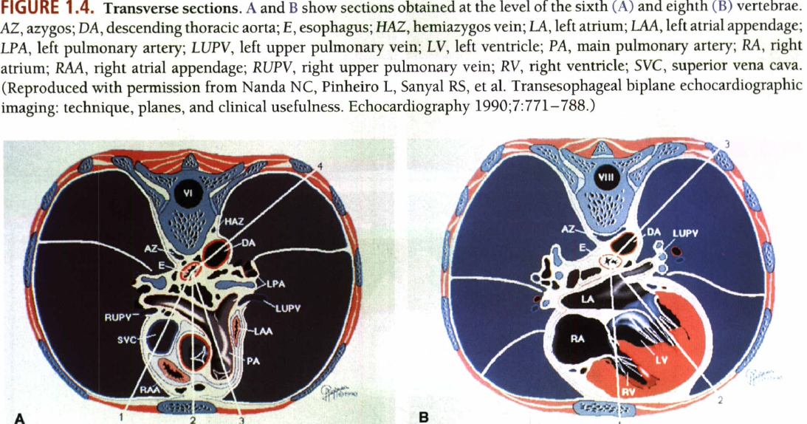

Slide 8
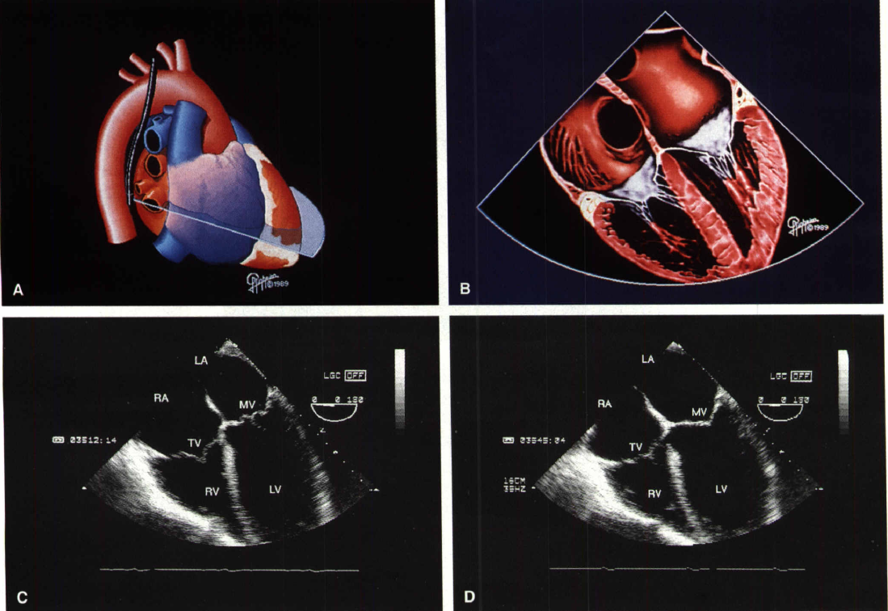
ME 4-Chamber View

Slide 9
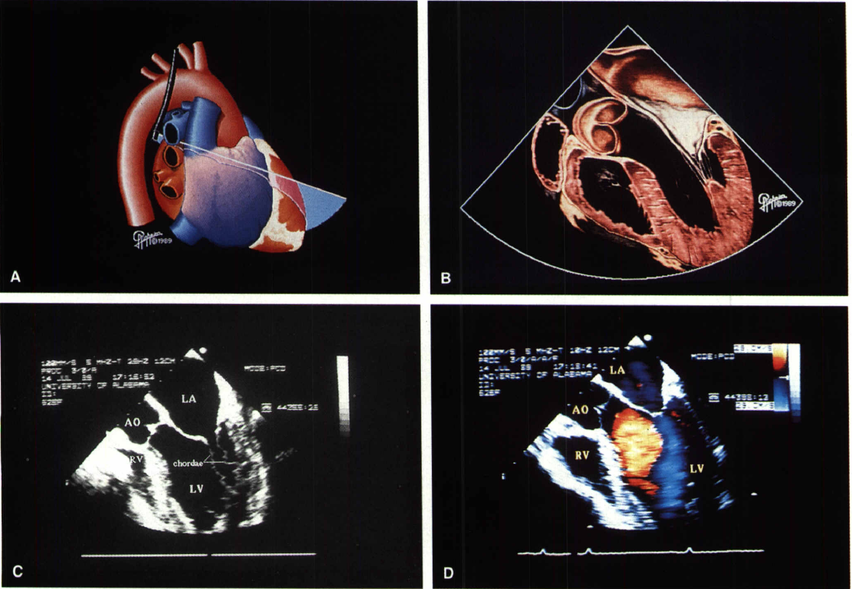
ME 5-Chamber View

Slide 10
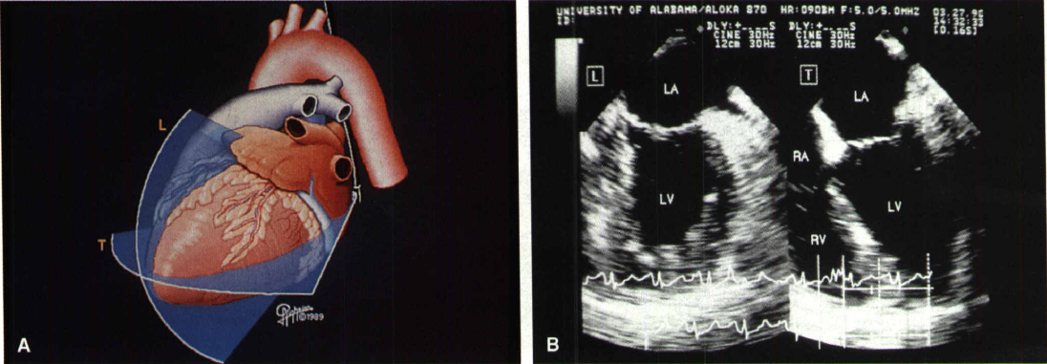
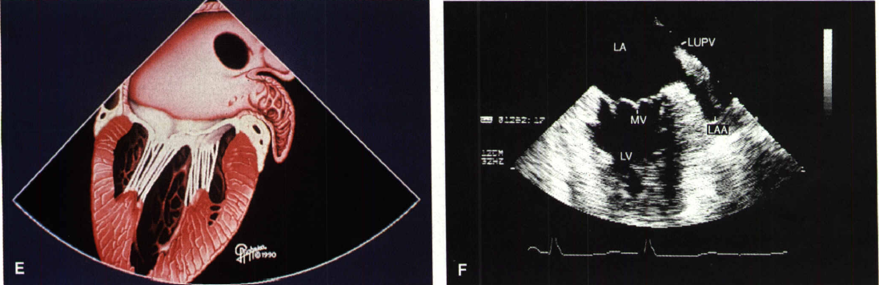
ME 2-Cahmber View

Slide 11
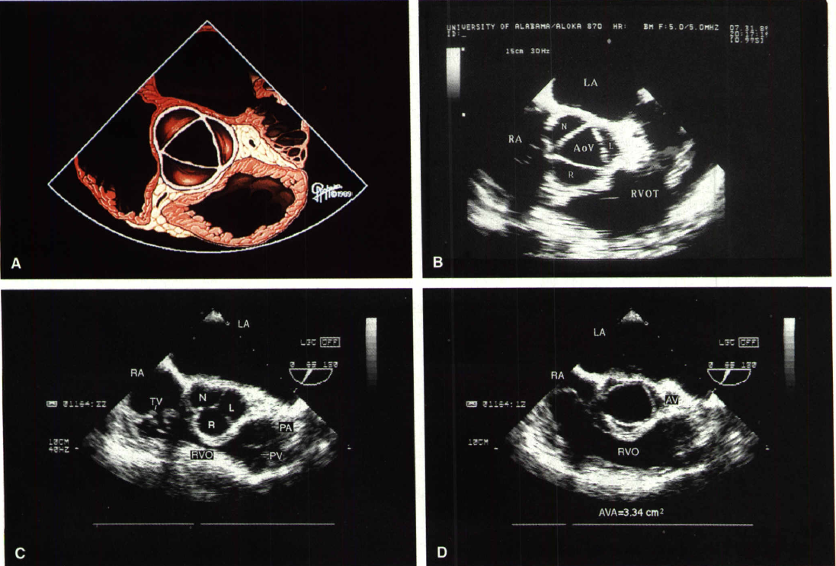
ME Aortic Valve Short Axis

Slide 12
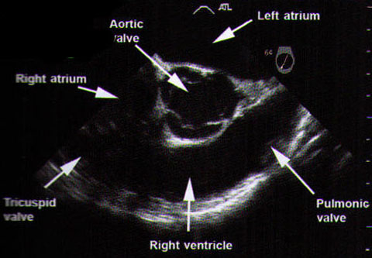
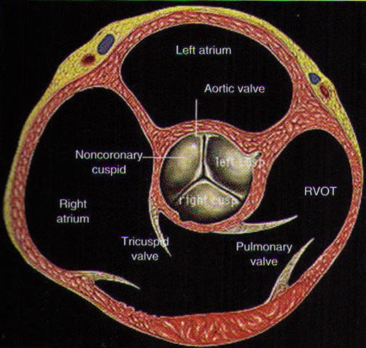
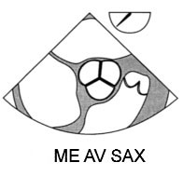
ME AV SAX (2)

Slide 13
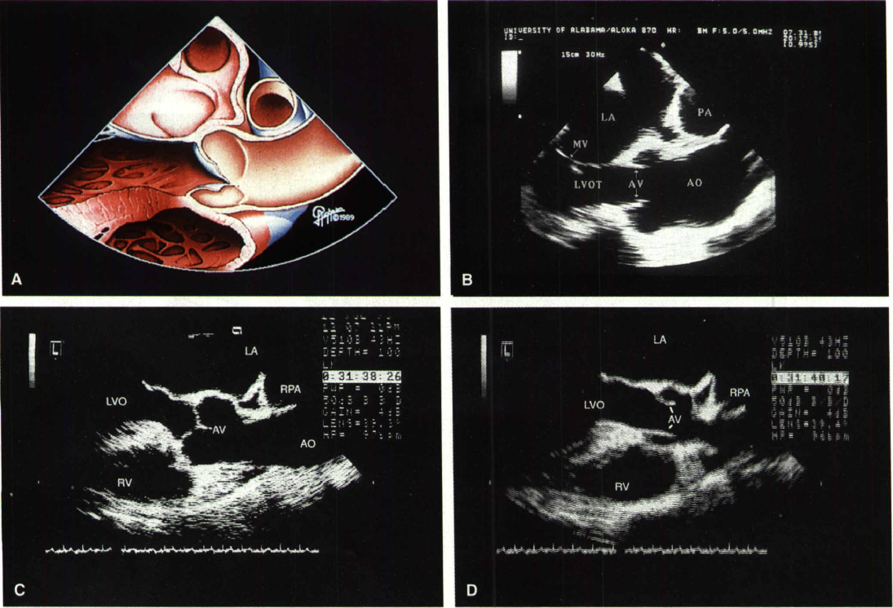
Aortic Root and Ascending Aorta
(ME AV LAX)
VSD site

Slide 14
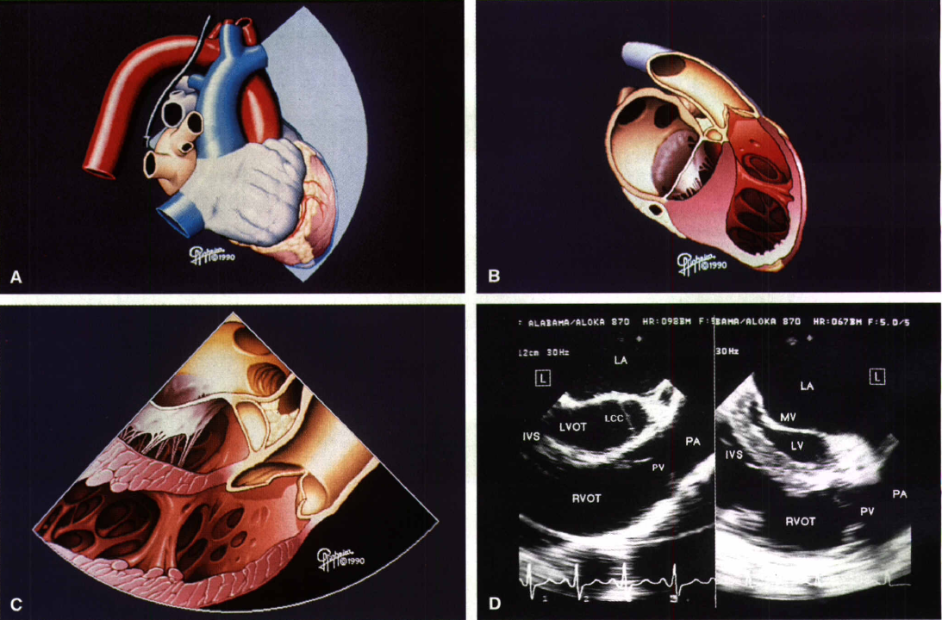
RV inflow & outflow and Pul. Valve
RV

Slide 15
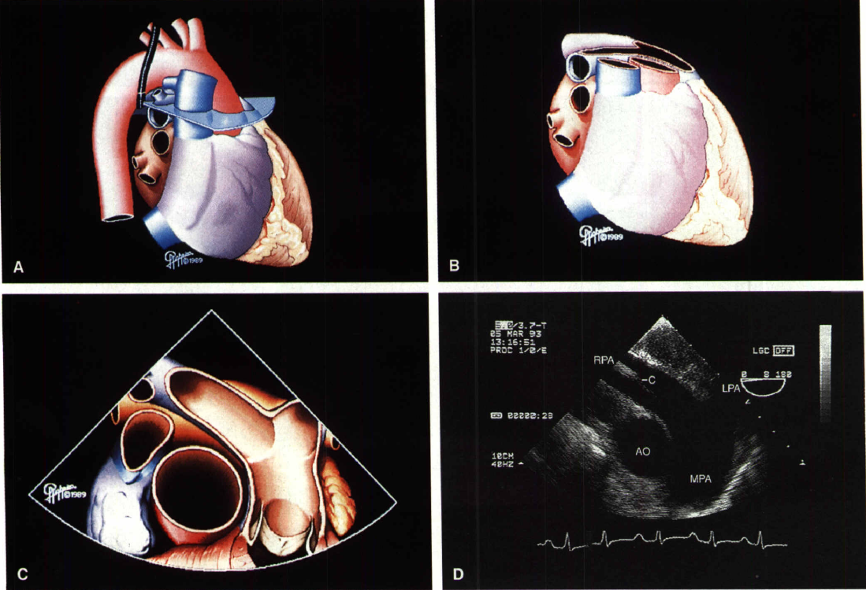
UE Asc Ao SAX &Pulmonary Artery
SVC
Ao

Slide 16
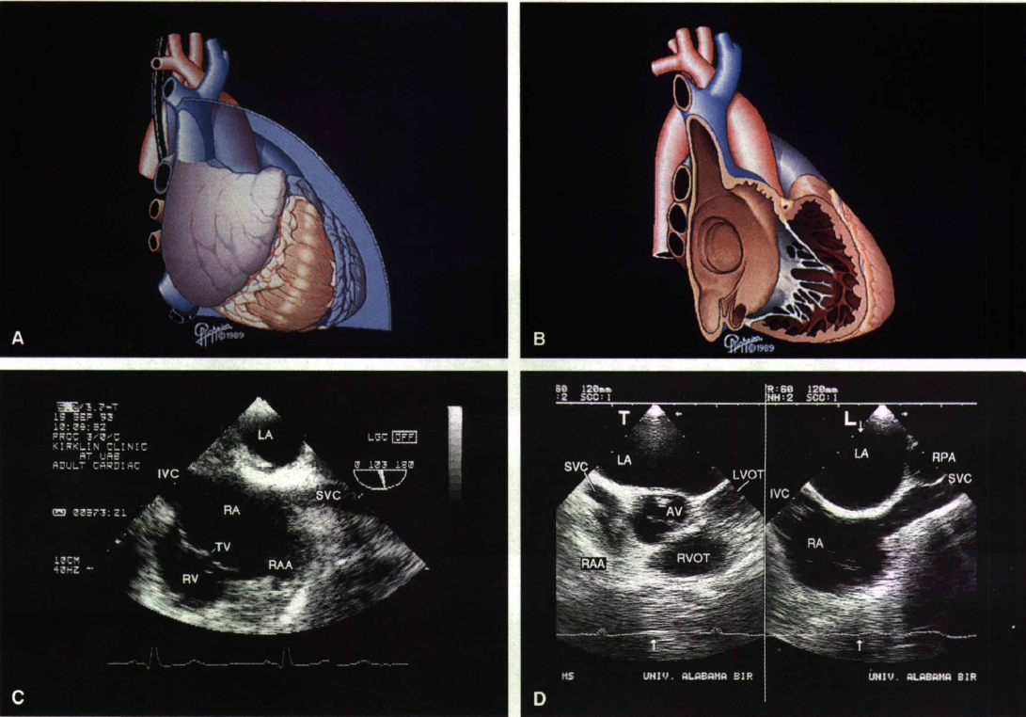
SVC and IVC (ME Bicaval View)
CS

Slide 17
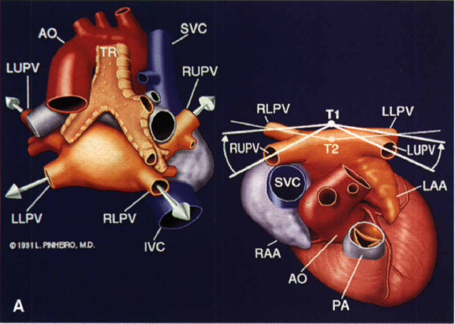
Pulmonary Veins

Slide 18
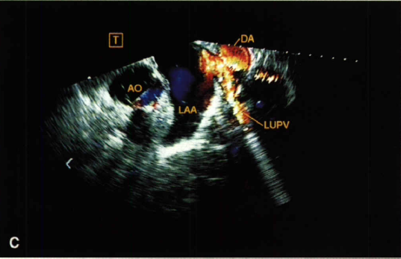
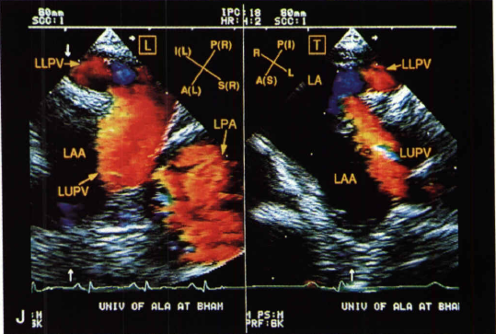
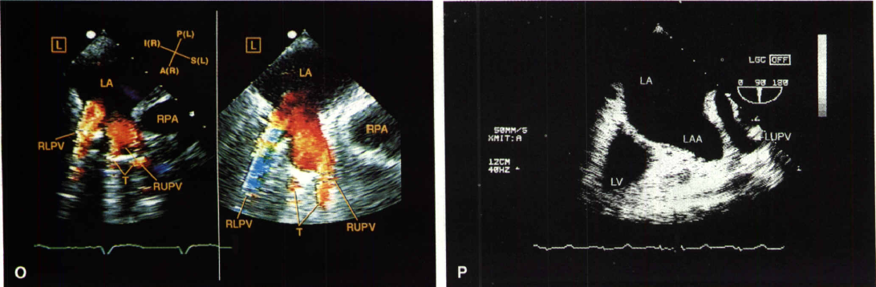

Slide 19
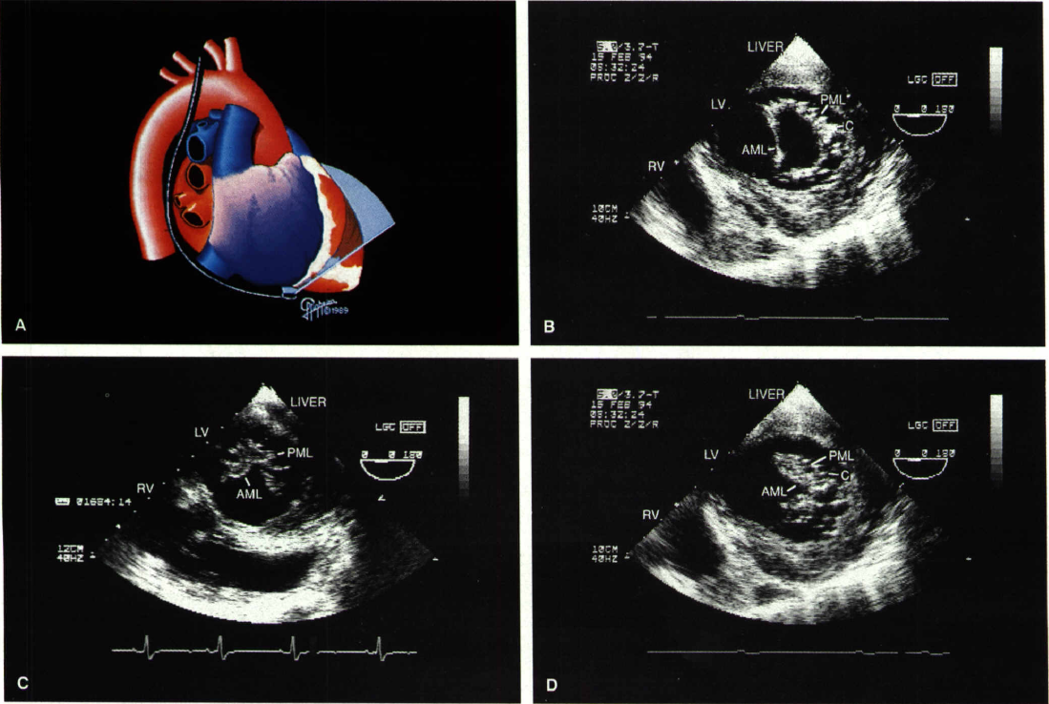
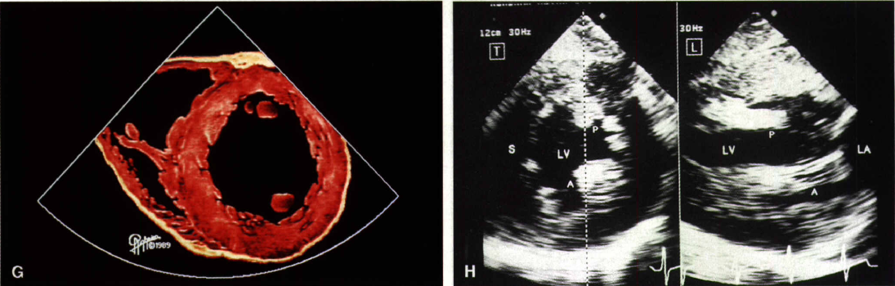
Transgastric Short-axis View
Inf Wall
Spt Wall
Lat Wall
Ant Wall

Slide 20
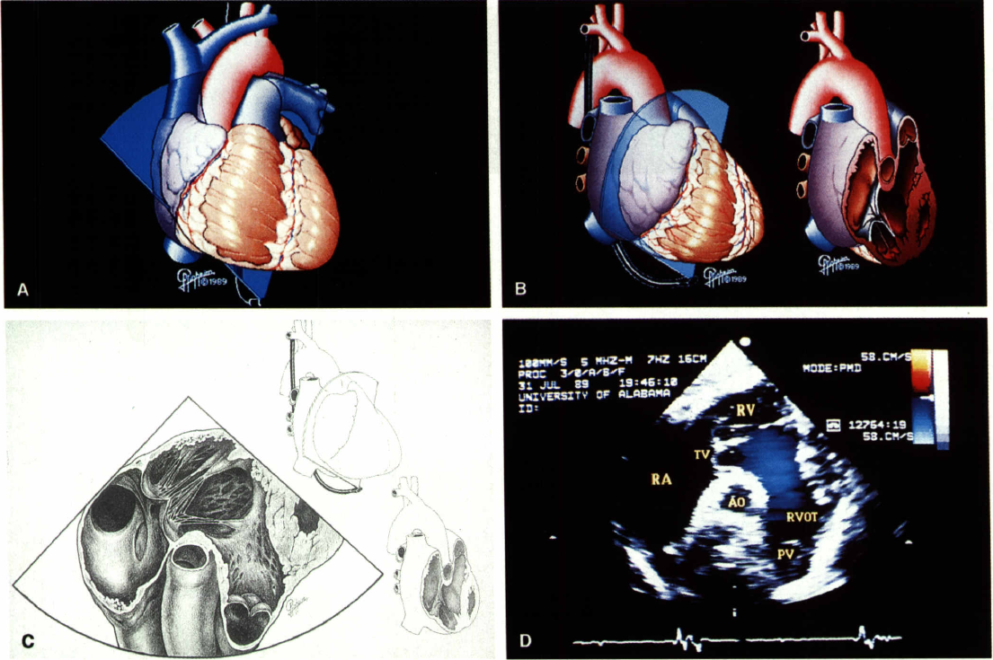
Transgastric SAX View
(More Anterior Angulation)

Slide 21
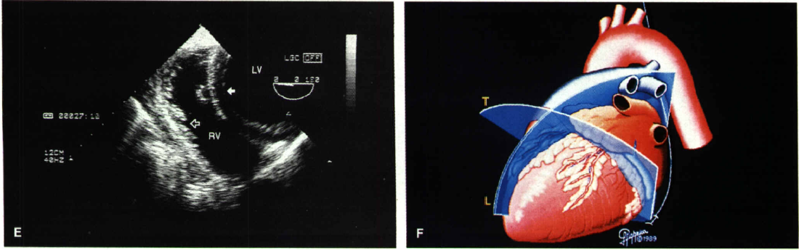
TG SAX & LAX Views
TG LAX
TG SAX

Slide 22
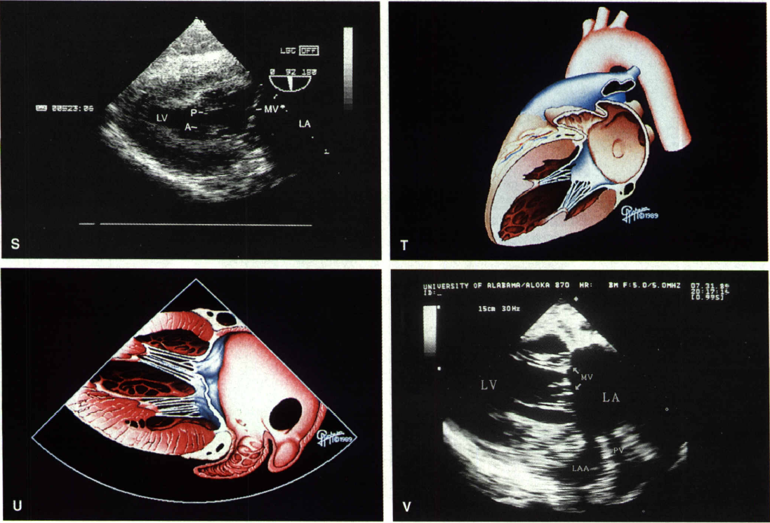
TG LAX 2-Chamber View

Slide 23
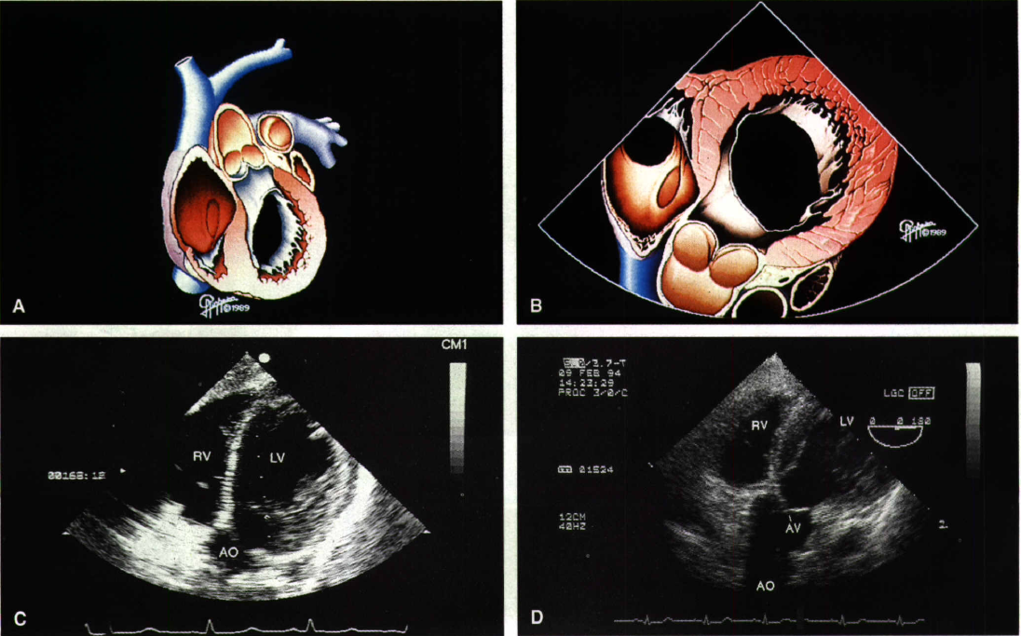
Deep TG LAX (Aortic Root) View
(More Anterior Angulation)
LVOT

Slide 24
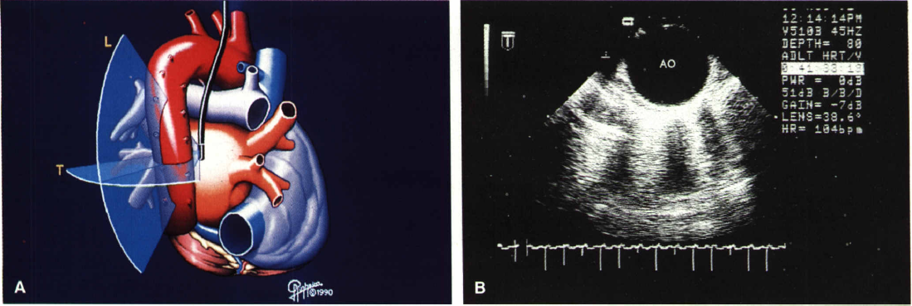
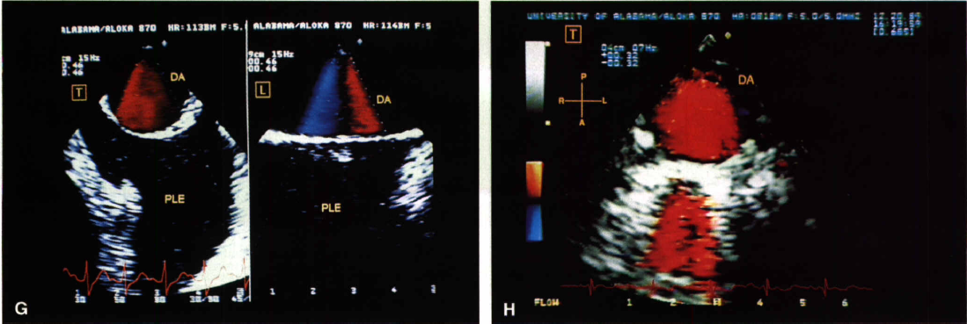
Descending Thoracic Aorta SAX & LAX
Blind Spot

Slide 25
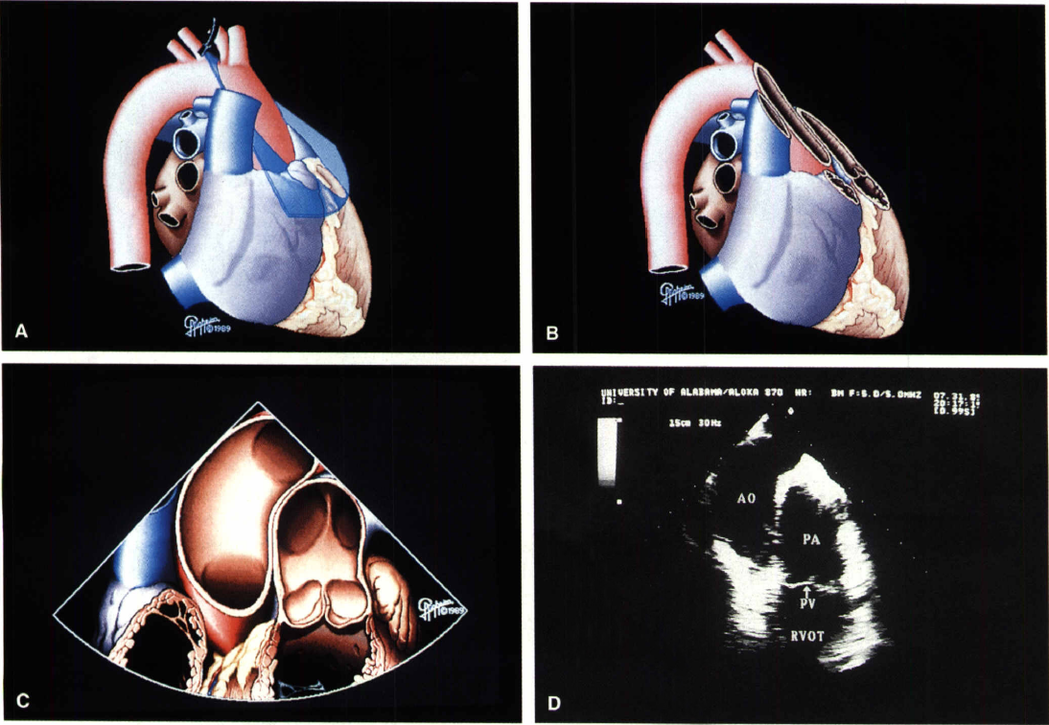
UE Aortic Arch and PA
PDA site

Slide 26
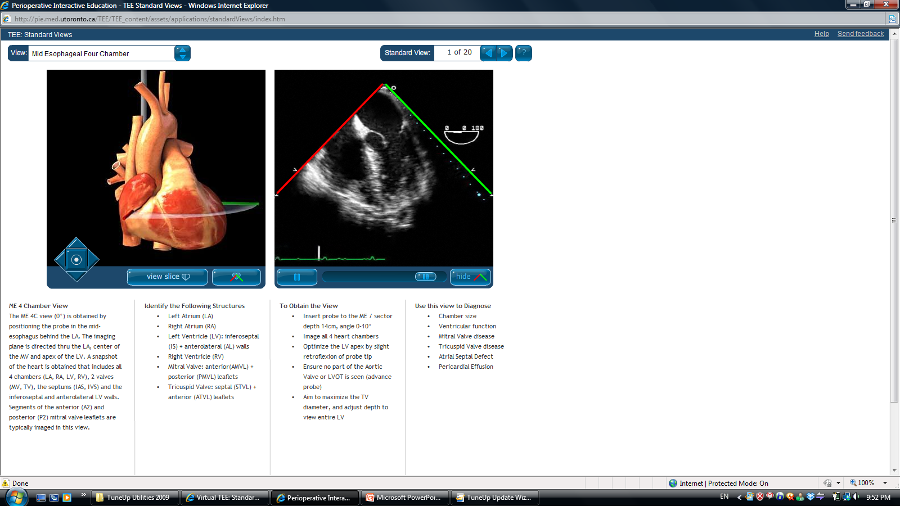
http://pie.med.utoronto.ca/TEE/TEE_content/assets/applications/standardViews/index.htm
Virtual TEE

Slide 27
